Slide 2

С++ Contracts
Antony Polukhin
Полухин Антон
Author of Boost's TypeIndex, DLL, Stacktrace
Maintainer of Boost Any, Conversion, LexicalСast, Variant
ISO WG21 national body

Slide 3
What are we going to talk about?
<number> / 50

Slide 4
What are we going to talk about?
What the hell is Contracts?
<number> / 50

Slide 5
What are we going to talk about?
What the hell is Contracts?
<algorithm> header
<number> / 50

Slide 6
What are we going to talk about?
What the hell is Contracts?
<algorithm> header
Big “O”
<number> / 50

Slide 7
What are we going to talk about?
What the hell is Contracts?
<algorithm> header
Big “O”
Contracts and algorithms
<number> / 50

Slide 8
Contracts

Slide 9
Contracts
Contracts – in development feature of the C++ language that allows to specify the function domain.
<number> / 50

Slide 10
Contracts — asserts on steroids
void push(int x, queue & q);
<number> / 50

Slide 11
Contracts — asserts on steroids
void push(int x, queue & q)
[[expects: !q.full()]]
[[ensures: !q.empty()]]
{
//...
[[assert: q.is_valid()]];
//...
}
<number> / 50

Slide 12
Contracts — asserts on steroids
void push(int x, queue & q) [[expects: !q.full()]] [[ensures: !q.empty()]] ;
queue q;
// ...
<number> / 50

Slide 13
Contracts — asserts on steroids
void push(int x, queue & q) [[expects: !q.full()]] [[ensures: !q.empty()]] ;
queue q;
// ...
if (!q.full()) {
push(10, q); // No need to check
if (q.empty()) { // Always false
}
} else {
push(11, q); // Suspicious!
}
<number> / 50

Slide 14
Contracts — asserts on steroids
void(const std::contract_violation &);
namespace std {
class contract_violation {
public:
int line_number() const noexcept;
const char * file_name() const noexcept;
const char * function_name() const noexcept;
const char * comment() const noexcept;
};
}
<number> / 50

Slide 15
<algorithm>

Slide 16
std::sort(beg, end)
Sorts in ascending order:
4 | 6 | 9 | 1 | 2 | 5 | 3 | 8 | 7 | 0 | @
<number> / 50

Slide 17
std::sort(beg, end)
Sorts in ascending order:
4 | 6 | 9 | 1 | 2 | 5 | 3 | 8 | 7 | 0 | @
0 | 1 | 2 | 3 | 4 | 5 | 6 | 7 | 8 | 9 | @
<number> / 50

Slide 18
std::sort(beg, end)
template <class RandomAccessIterator>
void sort(RandomAccessIterator beg, RandomAccessIterator end)
[[expects: beg <= end]]
[[ensures: is_sorted(beg, end)]]
;
<number> / 50

Slide 19
Big «О»

Slide 20
Big «О»
Big “О”– used to classify algorithms according to how their running time or space requirements grow as the input size N grows.
<number> / 50

Slide 21
Big «О»
Big “О”– used to classify algorithms according to how their running time or space requirements grow as the input size N grows.
for (size_t i = 0; i < N; ++i) => O(N)
<number> / 50

Slide 22
Big «О»
Big “О”– used to classify algorithms according to how their running time or space requirements grow as the input size N grows.
for (size_t i = 0; i < N; ++i) => O(N)
for (size_t i = 0; i < N; ++i)
for (size_t j = 0; j < N; ++j) => O(N²)
<number> / 50

Slide 23
Big «О»
N | N*log(N) | N*N
2 | 2 | 4
4 | 8 | 16
8 | 24 | 64
16 | 64 | 256
32 | 160 | 1,024
64 | 384 | 4,096
128 | 896 | 16,384
256 | 2,048 | 65,536
512 | 4,608 | 262,144
1,024 | 10,240 | 1,048,576
<number> / 50

Slide 24
Big «О»
std::sort => O( N*log₂(N) )
<number> / 50

Slide 25
Big «О»
std::sort => O( N*log₂(N) )
std::stable_sort => O( N*log₂²(N) )
<number> / 50

Slide 26
Big «О»
std::sort => O( N*log₂(N) )
std::stable_sort => O( N*log₂²(N) )
std::minmax_element => O( N )
std::nth_element => ~ O( N )
std::partial_sort => O( N*log₂(S) )
<number> / 50

Slide 27
std::nth_element(beg, mid, end)
Reorders the range [beg, end) so that:
        Value pointed to by mid does not change if we sort the range [beg, end)
        Left from mid are values less or equal to the value pointed to by mid
        Right from mid are values grater or equal to the value pointed to by mid
4 | 0 | 3 | 1 | 2 | 5 | 9 | 8 | 7 | 6 | @
<number> / 50

Slide 28
std::nth_element(beg, mid, end)
Reorders the range [beg, end) so that:
        Value pointed to by mid does not change if we sort the range [beg, end)
        Left from mid are values less or equal to the value pointed to by mid
        Right from mid are values grater or equal to the value pointed to by mid
4 | 0 | 3 | 1 | 2 | 5 | 9 | 8 | 7 | 6 | @
0 | 1 | 2 | 3 | 4 | 5 | 6 | 7 | 8 | 9 | @
<number> / 50

Slide 29
std::nth_element
Find 5 people with minimal balance
      std::nth_element(v.begin(), v.begin() + 4, v.end());
Find 5 people with maximal balance
std::nth_element(v.begin(), v.begin() + 4, v.end(), std::greater<>{});
Find the lucky 1001 caller
std::nth_element(v.begin(), v.begin() + 1000, v.end());
<number> / 50

Slide 30
std::partial_sort(beg, mid, end)
Reorders the range [beg, end) so that:
        Range [beg, mid) won't change if we sort the whole [beg, end) range
        Range [beg, mid) is sorted
0 | 1 | 2 | 3 | 4 | 9 | 5 | 8 | 7 | 6 | @
<number> / 50

Slide 31
std::partial_sort
Distribute 5 prizes according to minimal penalty points
      std::partial_sort(v.begin(), v.begin() + 5, v.end());
Punish 5 latecomer scholars
std::partial_sort(v.begin(), v.begin() + 5, v.end(), std::greater<>{});
<number> / 50

Slide 32
std::minmax_element
Find richest and poorest client:
auto mm = std::minmax_element(v.begin(), v.end());
std::cout << *mm.first << ' ' << *mm.second << '\n';
<number> / 50

Slide 33
The Question:

Slide 34
How to get a sorted list of 10 people with balance close to median?

Slide 35
(Effect same as if we sort everyone by balance and get 10 people from the middle).

Slide 36
HowTo?
auto it = v.begin() + v.size() / 2 — 5;
<number> / 50

Slide 37
HowTo?
auto it = v.begin() + v.size() / 2 — 5;
const auto f = [](const auto& v1, const auto& v2) {
return v1.balance() < v2.balance();
};
<number> / 50

Slide 38
HowTo?
auto it = v.begin() + v.size() / 2 — 5;
const auto f = [](const auto& v1, const auto& v2) {
return v1.balance() < v2.balance();
};
std::nth_element(v.begin(), it, v.end(), f);
<number> / 50

Slide 39
HowTo?
auto it = v.begin() + v.size() / 2 — 5;
const auto f = [](const auto& v1, const auto& v2) {
return v1.balance() < v2.balance();
};
std::nth_element(v.begin(), it, v.end(), f);
std::partial_sort(it + 1, it + 10, v.end(), f);
<number> / 50

Slide 40
O(N*log(10) ) vs O(N*log(N) )
N | N*log(10) N+(N/2-1)*log₂(9) | N*log(N) | N*log(N) – N*log(10)
10 | 33 | 33 | 0
16 | 53 | 64 | 11
512 | 1,701 | 4,608 | 2,907
16,384 | 54,426 | 229,376 | 174,950
524,288 | 1,741,647 | 9,961,472 | 8,219,825
16,777,216 | 55,732,705 | 402,653,184 | 346,920,479
<number> / 50

Slide 41
How to force the compiler to solve the previous task?

Slide 42
???
template <class RandomAccessIterator>
void nth_element(RandomAccessIterator beg, RandomAccessIterator mid, RandomAccessIterator end)
[[expects: beg <= mid]] [[expects: mid <= end]]
[[ensures: ??? ]]
;
template <class RandomAccessIterator>
void partial_sort(RandomAccessIterator beg, RandomAccessIterator mid, RandomAccessIterator end)
[[expects: beg <= mid]] [[expects: mid <= end]]
[[ensures: ??? ]]
;
<number> / 50

Slide 43
Contracts and algorithms

Slide 44
Conclusion
Contracts – in development feature of the C++ language that allows to specify the function domain:
<number> / 50

Slide 45
Conclusion
Contracts – in development feature of the C++ language that allows to specify the function domain:
        Unified syntax
<number> / 50

Slide 46
Conclusion
Contracts – in development feature of the C++ language that allows to specify the function domain:
        Unified syntax
        Start of the long way to formal verification
<number> / 50

Slide 47
Conclusion
Contracts – in development feature of the C++ language that allows to specify the function domain:
        Unified syntax
        Start of the long way to formal verification
        Optimization hints
<number> / 50

Slide 48
Conclusion
Contracts – in development feature of the C++ language that allows to specify the function domain:
        Unified syntax
        Start of the long way to formal verification
        Optimization hints
        Problems
<number> / 50

Slide 49
Conclusion
Contracts – in development feature of the C++ language that allows to specify the function domain:
        Unified syntax
        Start of the long way to formal verification
        Optimization hints
        Problems
        New horizons for research :-)
<number> / 50

Slide 50
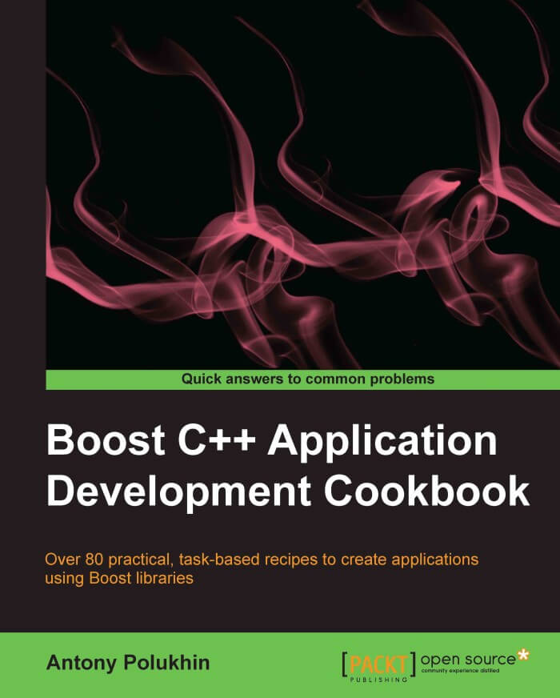
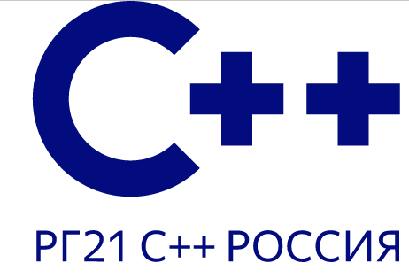
Thank you! Questions? https://stdcpp.ru
http://apolukhin.github.io/Boost-Cookbook
<number> / 50

